Slide 1
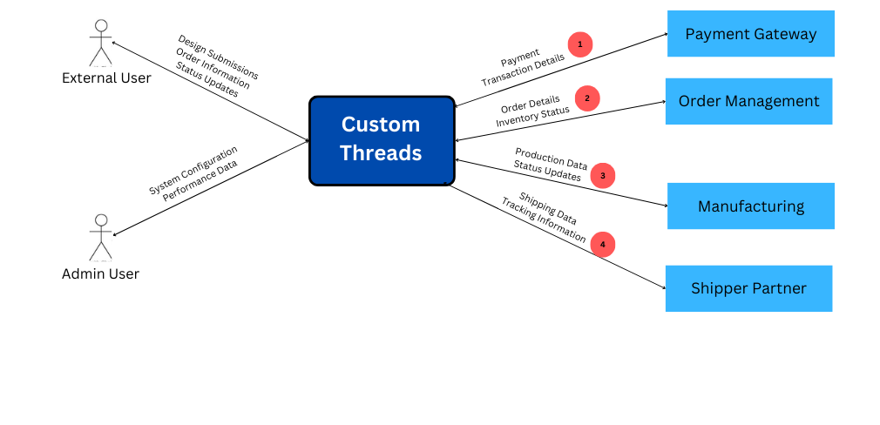
Team 4 - Custom Threads Context Diagram

Slide 2
No | Description | Source | Target | Frequency | Validation
1a | Processes online payments | Payment Gateway | CustomThreads | Real-time | Transaction validation, fraud detection, status updates
1b | Provides transaction details to system | CustomThreads | Payment Gateway | Real-time | Payment confirmation, refund processing
2a | Manages order details & inventory updates | Order Management | CustomThreads | Real-time | Order accuracy, stock availability verification
2b | Sends order status and inventory data | CustomThreads | Order Management | Real-time | Inventory levels, order fulfillment tracking
3a | Manages production status updates | Manufacturing | CustomThreads | Scheduled | Production progress tracking, quality checks

Slide 3
No | Description | Source | Target | Frequency | Validation
3b | Provides production data | CustomThreads | Manufacturing | Scheduled | Order completion status, defect tracking
4a | Handles shipping and tracking data | Handles shipping and tracking data | CustomThreads | Event-based | Shipment tracking, estimated delivery time validation
4b | Provides shipping details | CustomThreads | Shipper Partner | Event-based | Package handoff confirmation, tracking updates

